Slide 1
Network Layer
Routing Algorithms
Congestion Control
Quality of Service
Internetworking
Network Layer of the Internet
CN5E by Tanenbaum & Wetherall, © Pearson Education-Prentice Hall and D. Wetherall, 2011

Slide 2
The Network Layer
Application
Transport
Network
Link
Physical
Responsible for delivering packets between endpoints over multiple links
CN5E by Tanenbaum & Wetherall, © Pearson Education-Prentice Hall and D. Wetherall, 2011

Slide 3
Internet Protocol
IP is the main protocol used at the Network layer
  Gives devices logical addresses (IP addresses)
  Deliver packets from one network to another
  Help routers determine where packets should go
IPv4 – internet protocol version 4
•
•
•
Most widely used version of IP It uses 32-bit addresses
A 32-bit address allows approx. 4.29 billion unique addresses
192.168.10.25

Slide 4
IPv4 limitation
When the internet first started, do you think engineers expected billions of smartphones, laptops, smart TVs, and IoT devices?
Imagine a town with only 100 houses
Eventually:
  House 101 cannot exist
  New houses cannot receive unique addresses Solution is either:
  Build another town, or
  Create a new addressing system
  IPv6 –
  Uses 128-bit addresses
  Supports approx. 3.4x10exp(38) unique addresses
  2001:0db8:85a3:0000:0000:8a2e:0370:7334

Slide 5
Network Layer Functions
Addressing
  Used to direct messages from S to D
  Addresses are assigned in various ways (e.g., by system administrators, ICANN, hardware vendors, etc.)
  Addresses exist at different layers
  Addresses may be translated (resolved) from one layer to another (e.g., DNS, ARP)
Address Type Application layer | Example Uniform Resource Locator (URL) | Example Address www.indiana.edu
Network layer | IP address | 129.79.78.193 (4 bytes)
Data link layer | MAC address | 1C-6F-65-F8-33-8A (6 bytes)

Slide 6
Network Layer Functions
Addressing
  IPv4 addresses are 32 bits
  Most common way to write is using dot-decimal notation
    Easier for people to read and remember
    Breaks the address into four bytes and writes each byte in decimal notation instead of binary
    Example: 129.79.78.193
10000001 | 01001111 | 01001110 | 11000001

Slide 7
Network Layer Functions
Addressing
  A portion of an IP address represents the network and the rest identifies the host
  Classful addressing
    Uses the first bits to determine number of hosts
    Discontinued, but nomenclature still used
  Classless Inter-Domain Routing (CIDR)
    Uses subnet masks to more flexibly divide address space into subnets
      IP address: 129.79.78.193
      Subnet Mask: 255.255.255.0

Slide 8
Network Layer Functions
Dynamic addressing
  Configuring each device manually is time- consuming
  Assigning addresses permanently can be inefficient when devices are not connected to the network
  A server can supply IP addresses automatically
  Dynamic Host Configuration Protocol (DHCP)
•
•
•
•
Most common protocol for dynamic addressing Device sends out broadcast message
DHCP responds with IP settings
Addresses are “leased” for a length of time

Slide 9
Network Layer Functions
Address resolution
  Host (server) name resolution
    Translate host name to IP address
    e.g., www.indiana.edu → 129.79.78.193
    Domain Name Service (DNS)
  MAC address resolution
    Identify MAC address of the next device in the circuit
    Address Resolution Protocol (ARP)

Slide 10
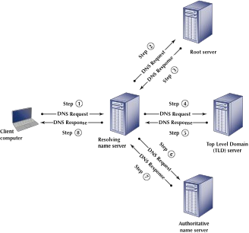
Network Layer Functions

Slide 11
Routing
  Process of identifying what path to have a packet take through a network from S to R.
  Routing Tables
    Used to make routing decisions
    Shows which path to send packets on to reach a given destination
    Kept by computers making routing decisions
  Routers
    Special-purpose devices used to handle routing decisions on the Internet
    Maintain their own routing tables
Dest. Next
B B
C B
D D
E D
F D
G B

Slide 12
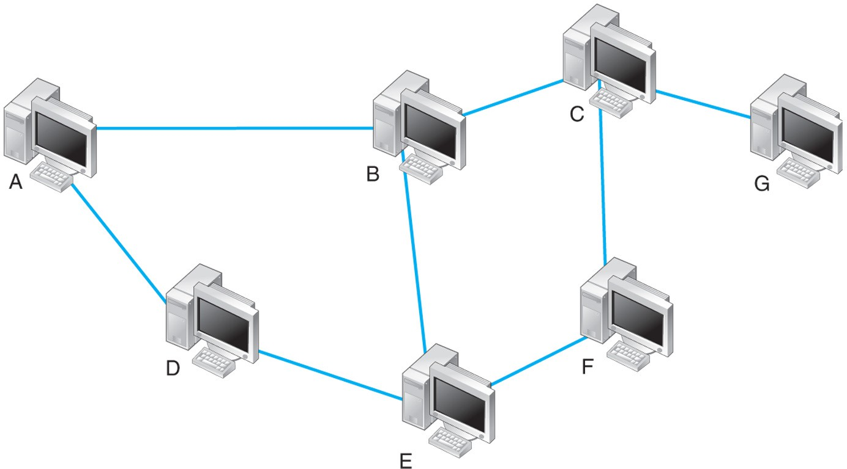
Routing
What are the possible paths from A to G?
ABCG
ABEFCG
ADEFCG
ADEBCG
Simplified Routing Table for A
Dest. Next
B B
C B
D D
E D
F D
G B

Slide 13
Routing
Centralized Routing
  Routing decisions made by one computer
  Not common anymore
Decentralized Routing
  Decisions are made by each node independently of one another
  Information needs to be exchanged to prepare routing tables.
  Used by the Internet

Slide 14
Routing
Static
  Fixed routing tables
  Manually configured by network managers
  Local adjustments when computers are added or removed
Dynamic
  Routing tables updated periodically
  Routers exchange information using protocols to update tables

Slide 15
Routing
Dynamic routing algorithms
  Distance vector: based on the number of “hops” between two devices
  Link state: based on the number of hops, circuit speed, and traffic congestion.
    Provides more reliable, up-to-date paths to destinations

Slide 16
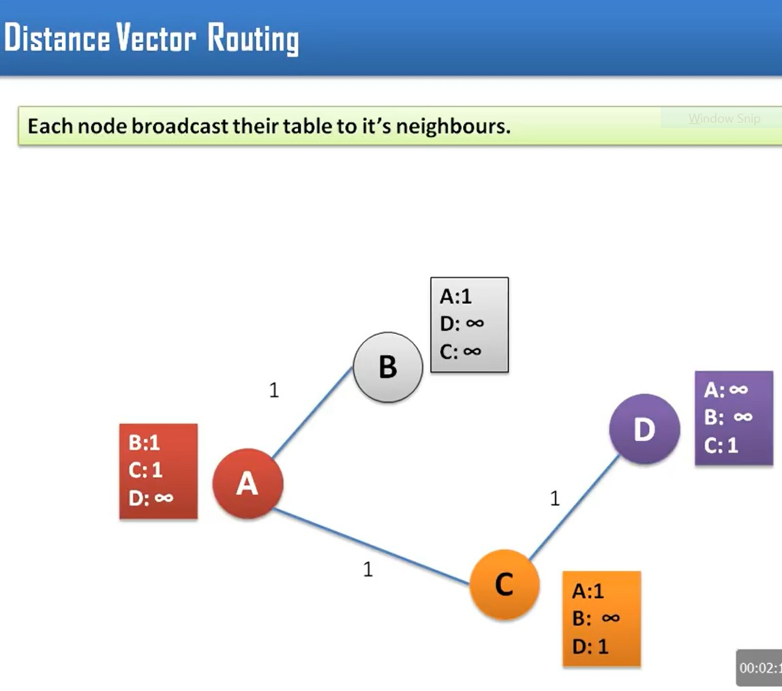
Distance vector routing

Slide 17
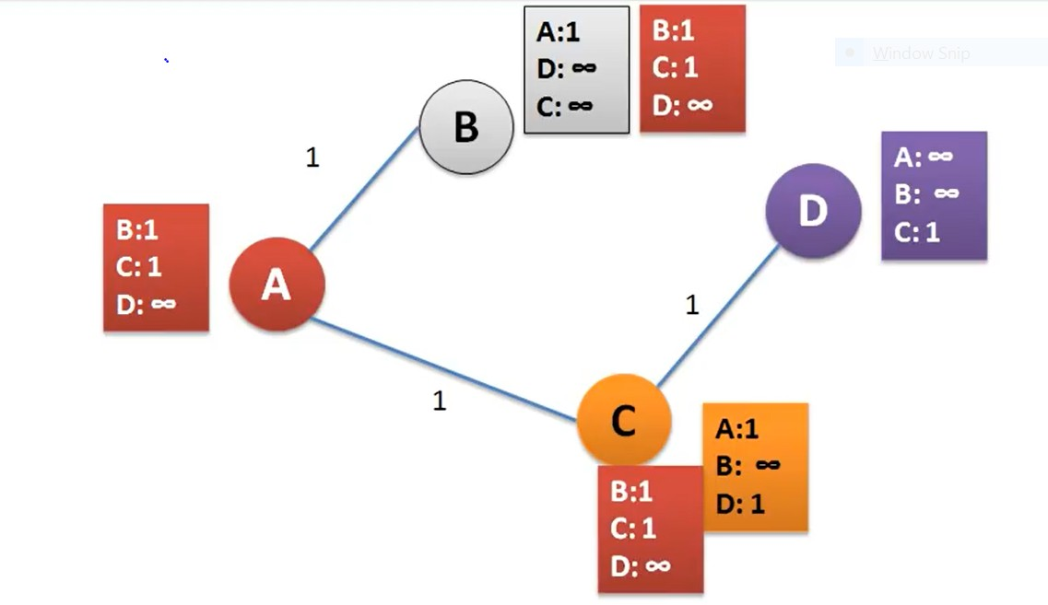
DVR cont..

Slide 18
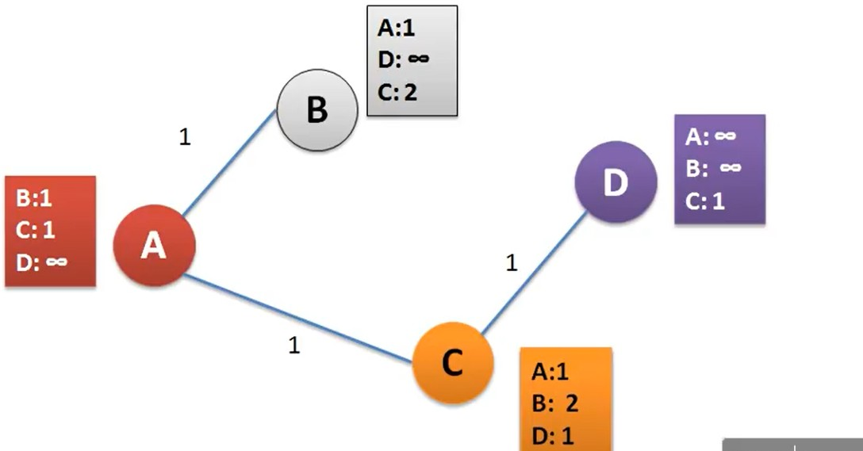
Update routing table

Slide 19
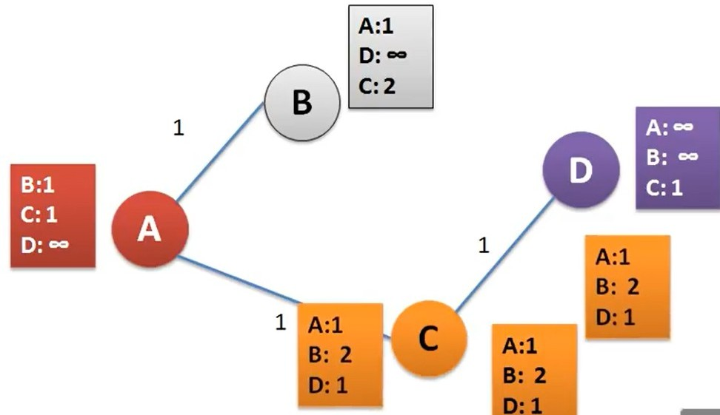
DVR cont..
C is broadcasting its table to neighbouring nodes

Slide 20
DVR cont..
Lets update Node A and B routing table

Slide 21
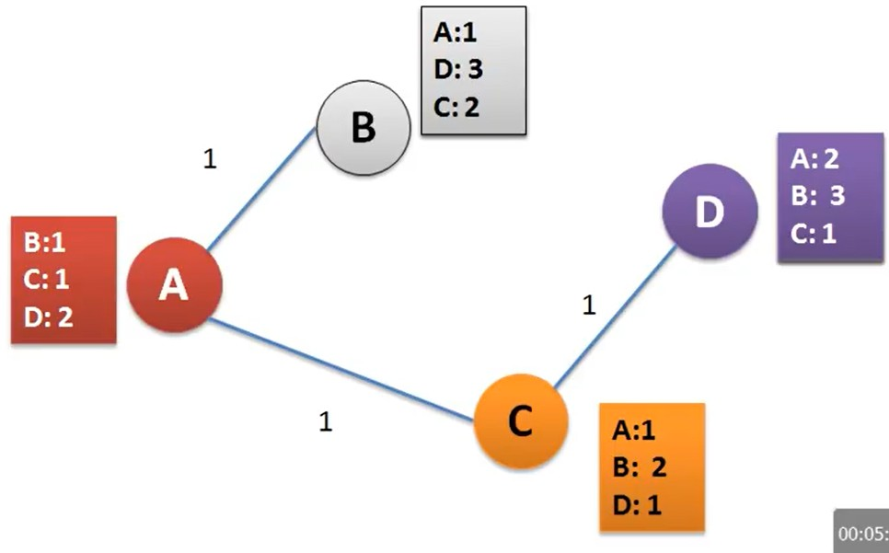
Updated table
The routing table is now stable and updated

Slide 22
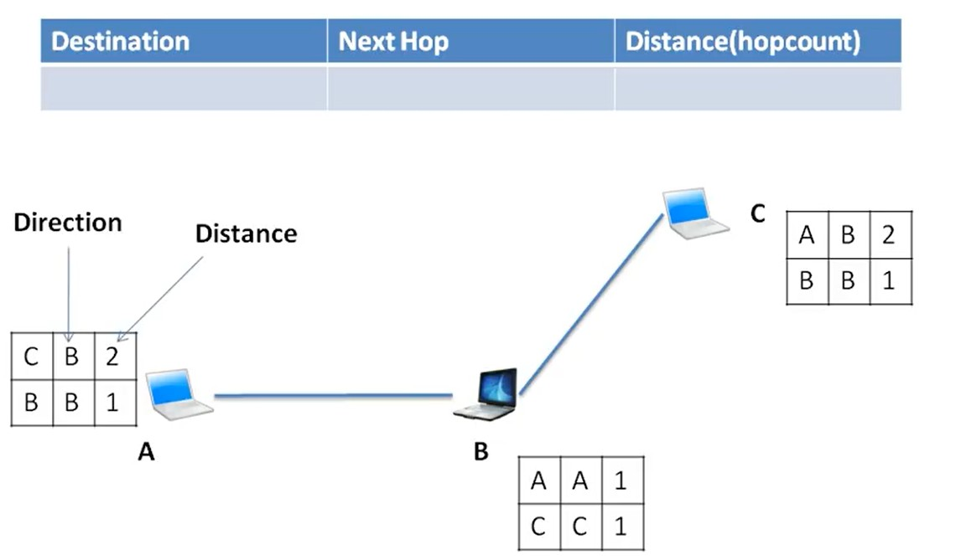
DVR

Slide 23
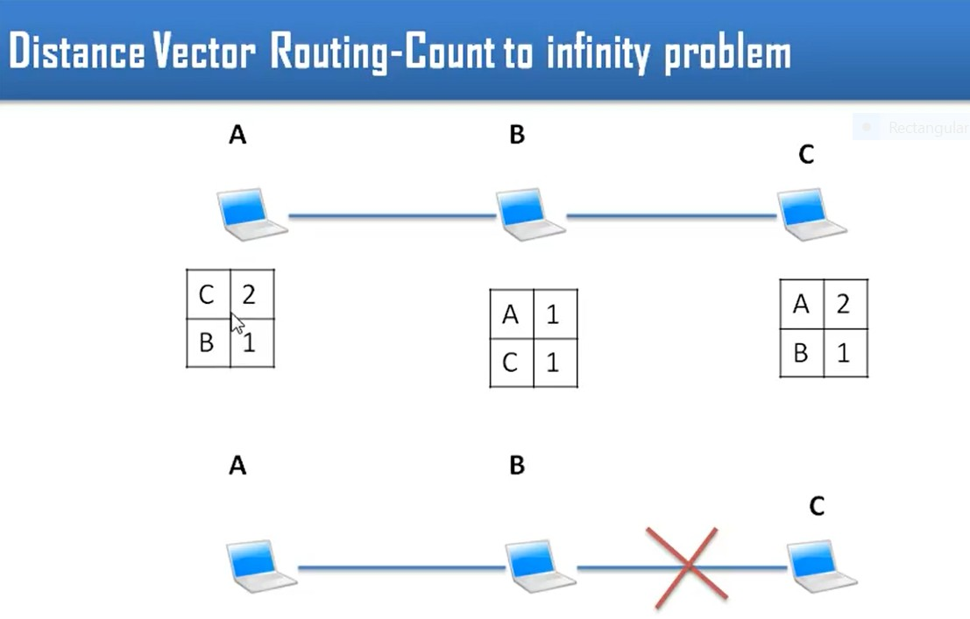
DRV problem

Slide 24
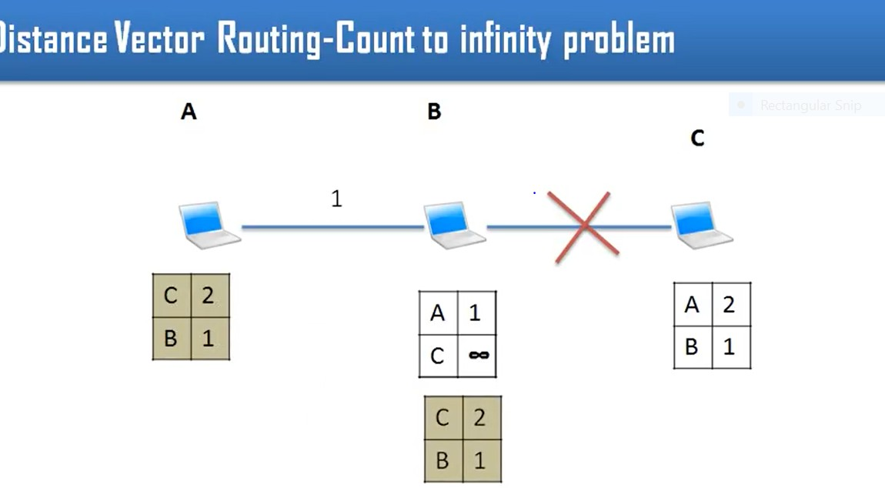
DVR problem cont…

Slide 25
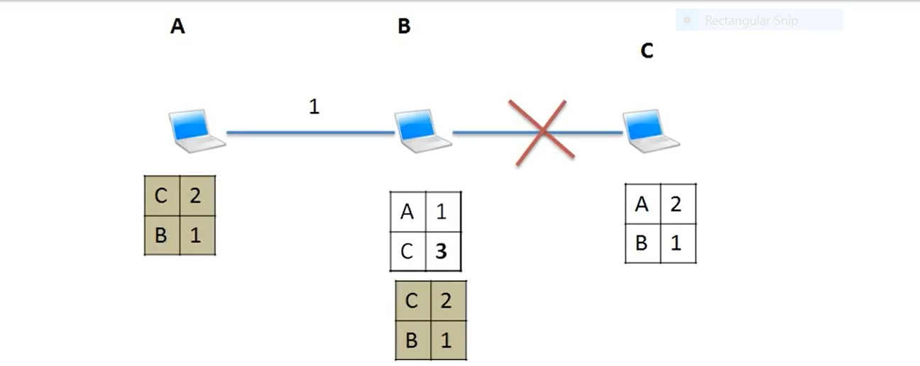
DVR problem updated
B routing table is updated

Slide 26
Routing Protocols
Routing Information Protocol (RIP)
  Dynamic distance vector protocol used for interior routing
  Operation
    Network manager builds the routing table
    Routing tables broadcast periodically (e.g., every minute or so)
    When new computers are added, router counts “hops” and selects the shortest route
  Useful in smaller, less complex networks

Slide 27
Routing Protocols
Open Shortest Path First (OSPF)
  Dynamic link-state protocol used for interior routing
  Most widely used interior routing protocol on large enterprise networks
  More reliable paths
  Less burdensome to the network because only updates are sent

Slide 28
Routing Protocols
Enhanced Interior Gateway RP (EIGRP)
  A dynamic link state protocol (developed by Cisco)
  Records transmission capacity, delay time, reliability and load for all paths
  Keeps the routing tables for its neighbors and uses this information in its routing decisions as well.

Slide 29
Routing Protocols
If each network uses a different protocol internally, how are they able to communicate?
Border Gateway Protocol (BGP)
  Dynamic DV protocol used for exterior routing.
    Far more complex than interior routing protocols.
    Provide routing info only on selected routes (e.g., preferred or best route)

Slide 30
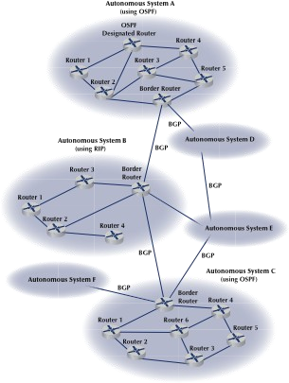
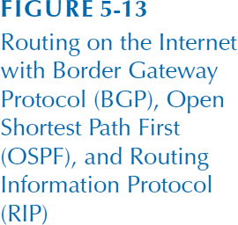

Slide 31
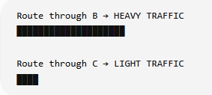
Congestion Control (1)
Handling congestion is the responsibility of the Network and Transport layers working together
We look at the Network portion here
Traffic-aware routing »
Admission control »
Traffic throttling »
Load shedding »
CN5E by Tanenbaum & Wetherall, © Pearson Education-Prentice Hall
and D. Wetherall, 2011

Slide 32
Congestion Control (2)
✓Congestion results when too much traffic is offered; performance degrades due to loss/retransmissions.
✓Low-bandwidth links or routers that process packets more slowly than the line rate can also become congested.
Flow control vs. congestion control
Congestion control - making sure the network is able to carry the offered traffic.
Flow control - relates to the traffic between a particular sender and a particular receiver
CN5E by Tanenbaum & Wetherall, © Pearson Education-Prentice Hall
and D. Wetherall, 2011

Slide 33
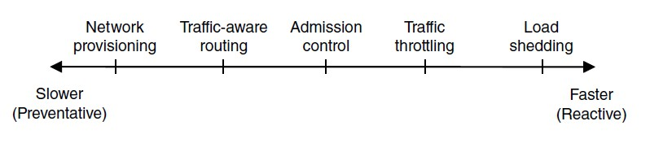
Congestion Control (1) – Approaches
Network must do its best with the offered load
Different approaches at different timescales
Nodes should also reduce offered load (Transport)
CN5E by Tanenbaum & Wetherall, © Pearson Education-Prentice Hall
and D. Wetherall, 2011

Slide 34
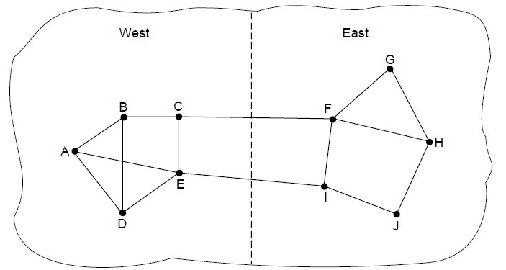
Traffic-Aware Routing
Choose routes depending on traffic, not just topology
E.g., use EI for West-to-East traffic if CF is loaded
But take care to avoid oscillations
CN5E by Tanenbaum & Wetherall, © Pearson Education-Prentice Hall
and D. Wetherall, 2011

Slide 35
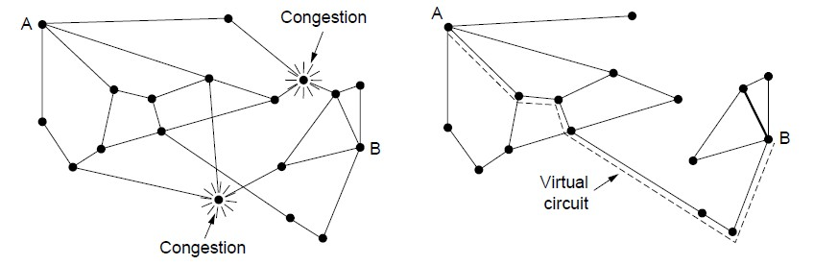
Admission Control
Admission control allows a new traffic load only if the network has sufficient capacity, e.g., with virtual circuits
  Can combine with looking for an uncongested route
Network with some congested nodes
Uncongested portion and route
AB around congestion
CN5E by Tanenbaum & Wetherall, © Pearson Education-Prentice Hall and D. Wetherall, 2011

Slide 36
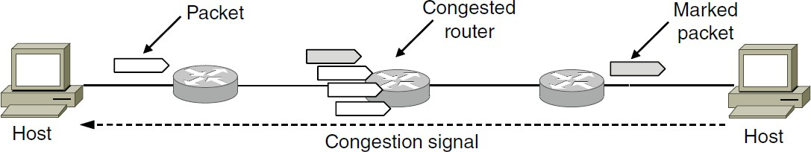
Traffic Throttling
Congested routers signal hosts to slow down traffic
ECN (Explicit Congestion Notification) marks packets and receiver returns signal to sender
CN5E by Tanenbaum & Wetherall, © Pearson Education-Prentice Hall and D. Wetherall, 2011

Slide 37
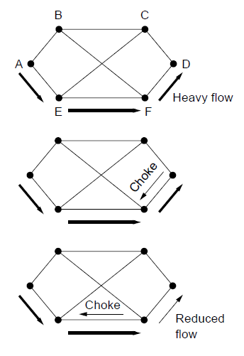
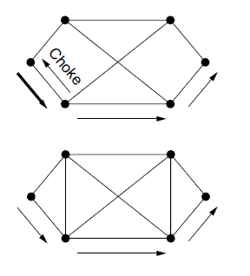



Load Shedding (1)
When all else fails, 1
4
network will drop
packets (shed load)
Can be done end-to-end or link-by-link
2
5
(right) produces rapid relief
3
CN5E by Tanenbaum & Wetherall, © Pearson
Education-Prentice Hall and D. Wetherall, 2011

Slide 38
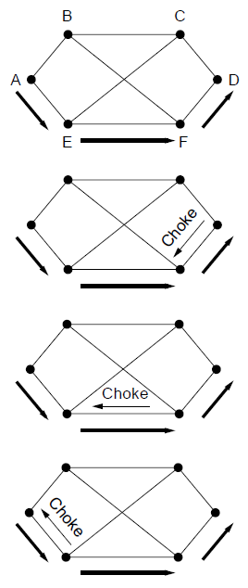
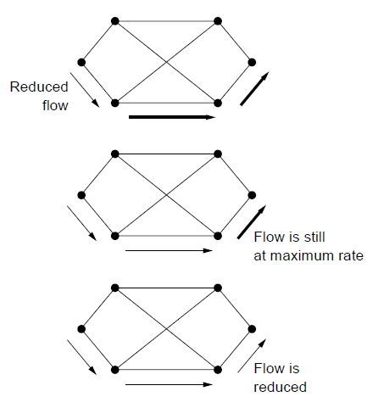




Load Shedding (2)
1
End-to-end (right) takes longer to have an effect, but can better target the cause of congestion
5
2
6
3
7
4
CN5E by Tanenbaum & Wetherall, © Pearson
Education-Prentice Hall and D. Wetherall, 2011

Slide 39
Quality of Service
Application requirements »
Traffic shaping »
Packet scheduling »
Admission control »
Integrated services »
Differentiated services »
CN5E by Tanenbaum & Wetherall, © Pearson Education-Prentice Hall and D. Wetherall, 2011

Slide 40
SEE YOU ON FRIDAY

Slide 41
Quality of Service

Slide 42
QoS
Ability of a network to manage traffic so that different applications receive the level of network performance they require
Not all network traffic has the same requirements
Suppose devices perform these activities concurrently:
  Making a whatsApp/ teams video call
  Downloading a 5 GB file
  Sending an email
If network becomes congested, which traffic should receive priority?

Slide 43
QOS
Four issues must be addressed to ensure quality of service
What applications need from the network.
How to regulate the traffic that enters the network.
How to reserve resources at routers to guarantee performance.
Whether the network can safely accept more traffic.
CN5E by Tanenbaum & Wetherall, © Pearson Education-Prentice Hall
and D. Wetherall, 2011

Slide 44
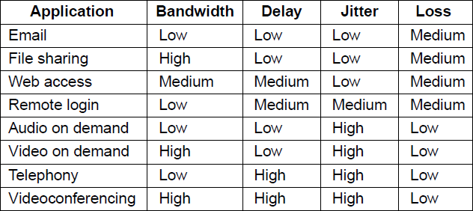
Application Requirements (1)
Different applications care about different properties
We want all applications to get what they need
.
“High” means a demanding requirement, e.g., low delay
CN5E by Tanenbaum & Wetherall, © Pearson Education-Prentice Hall
and D. Wetherall, 2011

Slide 45
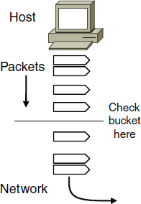
Traffic Shaping (1)
Traffic shaping regulates the average rate and burstiness of data entering the network
Lets us make guarantees
Shape traffic here
CN5E by Tanenbaum & Wetherall, © Pearson Education-Prentice Hall and D. Wetherall, 2011

Slide 46
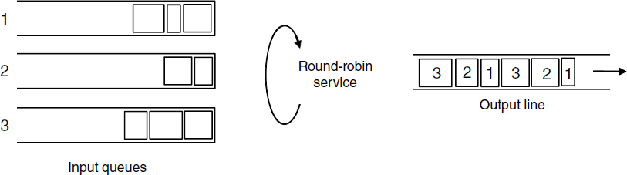
Packet Scheduling (1)
Packet scheduling divides router/link resources among traffic flows with alternatives to FIFO (First In First Out)
1 1
1
2
2
3
3
3
Example of round-robin queuing
CN5E by Tanenbaum & Wetherall, © Pearson Education-Prentice Hall
and D. Wetherall, 2011

Slide 47
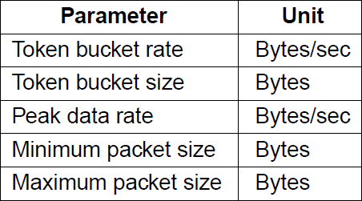
Admission Control (1)
Admission control takes a traffic flow specification and decides whether the network can carry it
Sets up packet scheduling to meet QoS
Example flow specification
CN5E by Tanenbaum & Wetherall, © Pearson Education-Prentice Hall
and D. Wetherall, 2011

Slide 48
Integrated Services (1)
Design with QoS for each flow; handles multicast traffic.
Admission with RSVP (Resource reSerVation Protocol):
Receiver sends a request back to the sender
Each router along the way reserves resources
Routers merge multiple requests for same flow
Entire path is set up, or reservation not made
CN5E by Tanenbaum & Wetherall, © Pearson Education-Prentice Hall
and D. Wetherall, 2011

Slide 49
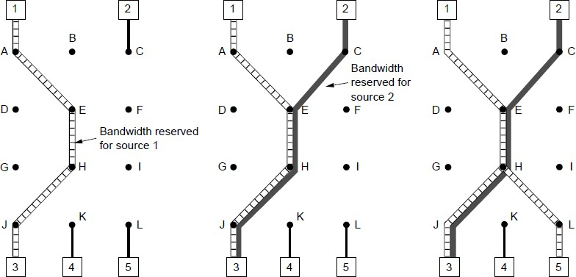

Integrated Services (2)
Merge
R3 reserves flow from S1
R3 reserves flow from S2
R5 reserves flow from S1; merged with R3 at H
CN5E by Tanenbaum & Wetherall, © Pearson
Education-Prentice Hall and D. Wetherall, 2011

Slide 50
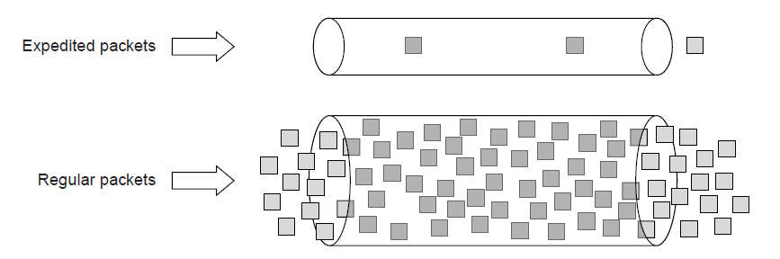
Differentiated Services (1)
Design with classes of QoS; customers buy what they want
  Expedited class is sent in preference to regular class
  Less expedited traffic but better quality for applications
CN5E by Tanenbaum & Wetherall, © Pearson
Education-Prentice Hall and D. Wetherall, 2011

Slide 51
Internetworking
Process of connecting multiple different networks into a single larger network.
•
•
Connected networks may use various technologies.
Have various packet sizes and operate differently internally
University have separate networks for library, computer labs, admin and student res. Though these networks designed differently, internetworking allows student in res access a server located on the library network.
CN5E by Tanenbaum & Wetherall, © Pearson Education-Prentice Hall
and D. Wetherall, 2011

Slide 52
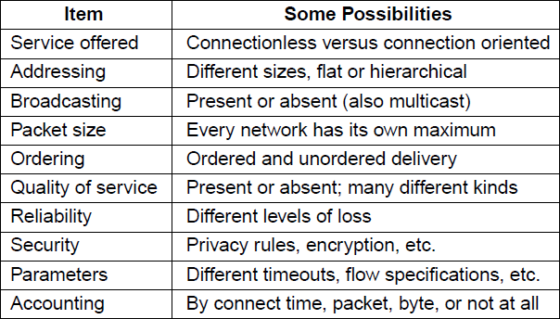
How Networks Differ
•
Various networks use differ technologies, addressing methods, packet sizes, protocols, and QoS mechanisms.
CN5E by Tanenbaum & Wetherall, © Pearson Education-Prentice Hall
and D. Wetherall, 2011

Slide 53
Example
A student sends data from a laptop connected to the university Wi-Fi network, and the data eventually travels through an ISP's network and other networks before reaching a web server. Although these networks may use different underlying technologies, the IP protocol allows the packet to continue towards its destination.
CN5E by Tanenbaum & Wetherall, © Pearson Education-Prentice Hall
and D. Wetherall, 2011

Slide 54
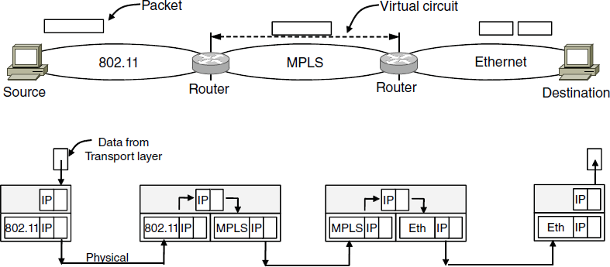
How Networks Can Be Connected
Internetworking based on a common network layer
– IP
Packet mapped to a VC here
Common protocol (IP) carried all the way
CN5E by Tanenbaum & Wetherall, © Pearson Education-Prentice Hall
and D. Wetherall, 2011

Slide 55
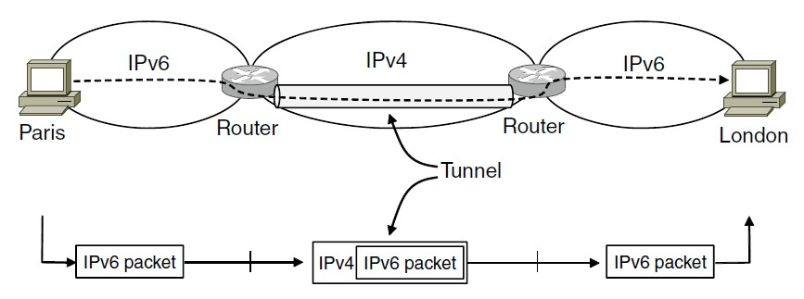
Tunneling (1)
Connects two similar networks through a middle one
Packets are encapsulated over the middle
Imagine two company IPv6 networks that
need to
communicate, but the network between them supports only IPv4. The IPv6 packet can be placed inside an IPv4 packet to cross the IPv4 network. At the other end, the IPv4 header is removed and the original IPv6 packet continues normally.

Slide 56
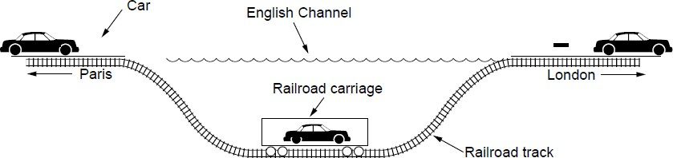
Tunneling (2)
Tunneling analogy:
tunnel is a link; packet can only enter/exit at ends
CN5E by Tanenbaum & Wetherall, © Pearson Education-Prentice Hall
and D. Wetherall, 2011

Slide 57
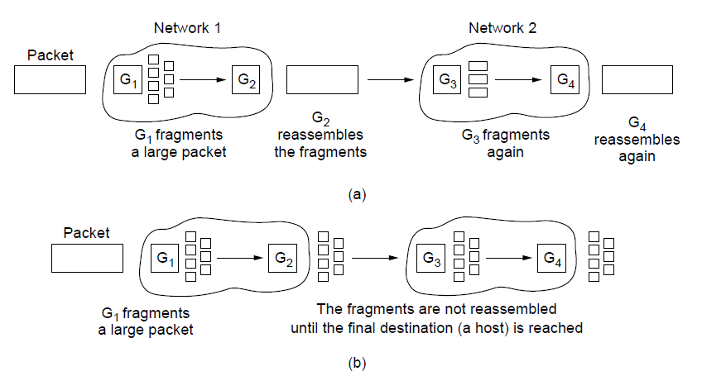
Packet Fragmentation (1)
Occurs when a large packet must travel through a network that supports a smaller max packet size
A large packet is divided into smaller pieces called fragments.
Transparent fragmentation- packets maybe reassembled before entering next network
Non-transparent, fragments remain separate and reassembled in the destination
G₁ fragments G₂ reassembles G₃ fragments G₄ reassembles
Transparent – packets fragmented / reassembled in each network
G fragments
… destination
1
will reassemble
Non-transparent – fragments are reassembled at destination

Slide 58
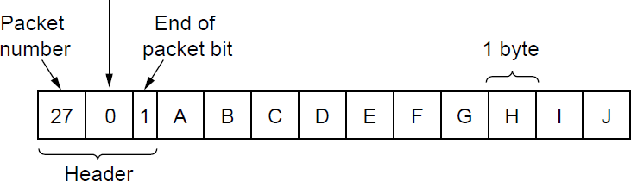
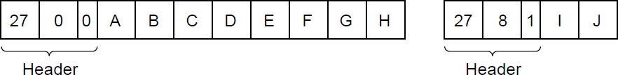
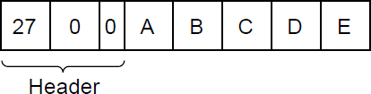
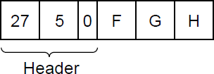
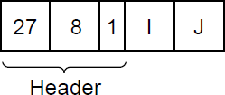
Packet Fragmentation (2)
Example of IP-style fragmentation:
Packet
Start
End bit
Original packet: (10 data bytes)
number offset
Fragmented:
(to 8 data bytes)
Re-fragmented: (to 5 bytes)
CN5E by Tanenbaum & Wetherall, © Pearson Education-Prentice Hall and D. Wetherall, 2011

Slide 59
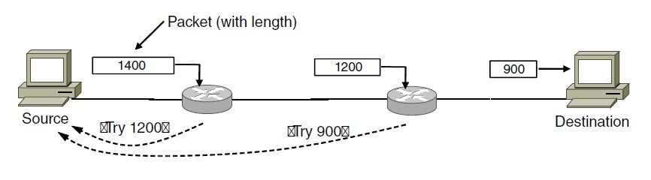
Packet Fragmentation (3)
•
Path MTU discovery: a technique used to avoid fragmentation
Determines the largest packet size that can travel across the entire path from S to D
If a packet is too large for one of the networks along the route
The router discards it & informs S about Max Trans Unit Sender will then reduce the packet size & tries again
•
•
•
•
Try 1200
Try 900
CN5E by Tanenbaum & Wetherall, © Pearson Education-Prentice Hall
and D. Wetherall, 2011

Slide 60
Network Layer in the Internet (1)
The Internet relies primarily on the Internet Protocol to move packets between different networks.
  IPV4- how packets are formatted & delivered using 32-bit IP
  IP – provides logical addresses that identify networks devices.
  IPV6 – new version of IP that uses 128-bit addresses
  Providing larger address space & other protocol improvements

Slide 61
Network Layer in the
Internet (2)
•
•
Design principles that shaped IP and the Internet
The Internet was designed to be practical, simple, scalable & connect various networks
Principles such as
•
•
•
•
•
Make sure it works Keep it simple Exploit modularity Expect heterogeneity
Example:
The internet connects a smartphone using wi-fi, university network using Ethernet and the ISP using fiber.
Differ technologies but IP was designed to across this heterogenous environment.

Slide 62
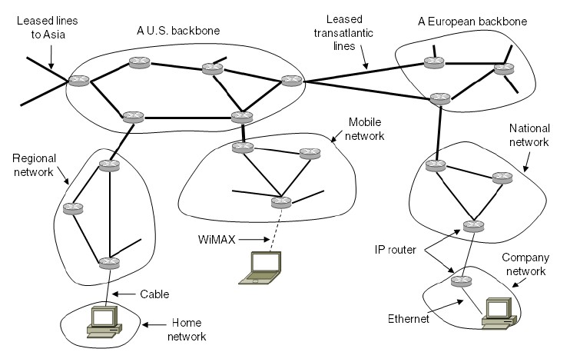
Network Layer in the
•InIntteernertniseantin(te3rc)onnected collection of many networks that is held together by the IP protocol
CN5E by Tanenbaum & Wetherall, © Pearson Education-Prentice Hall and D. Wetherall, 2011

Slide 63
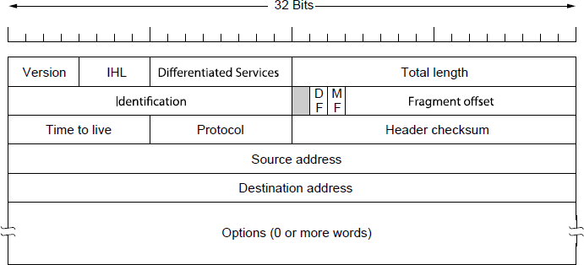
IP Version 4 Protocol (1)
•
•
•
IPv4 header attached to every packet
Has infor routers need to deliver & manage packet
Routers examine relevant fields in this header when forwarding the packet toward its destination.

Slide 64
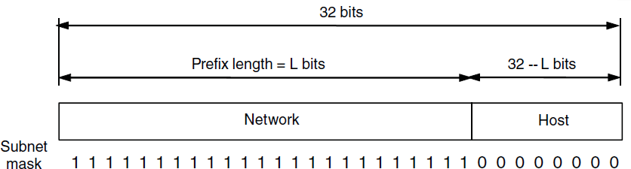
IP Addresses (1) – Prefixes
Addresses are allocated in blocks called prefixes
A prefix is determined by the network portion
Remaining bits are used as host addresses
Prefix is written using the format 192.168.1.0/24
Host bits being 8, 2^8=256 possible addresses
Block ranges from 192.168.1.0 – 192.168.1.255

Slide 65
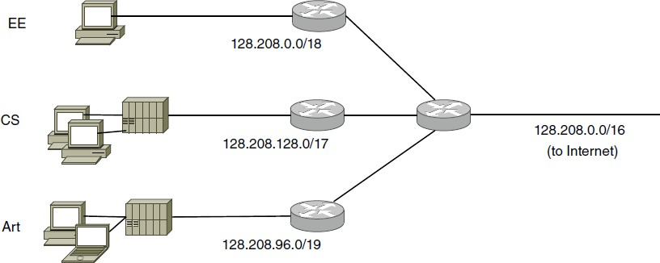
IP Addresses (2) – Subnets
•
Dividing a large IP address block into smaller networks called subnets.
An organization receives one IP prefix from the ISP Internally can be divide the prefix among the various
•
•
departments
ISP gives network a single prefix
Network divides it into subnets internally

Slide 66
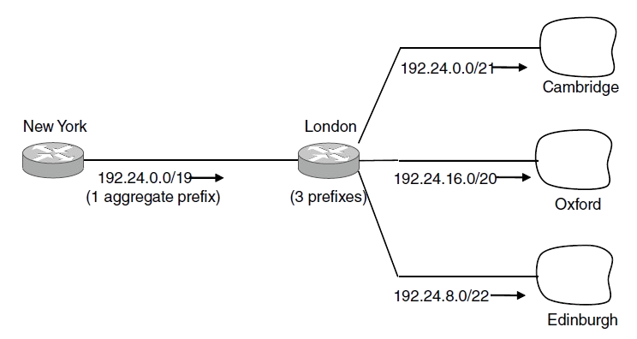
IP Addresses (3) – Aggregation
•
•
•
Process of combining several small IP prefixes into one large prefix To reduce the size of routing tables
Instead of ISP advertising separate routes for every customer network,
It advertises one larger prefix that represents those customers
•
ISP advertises a single prefix
ISP customers have different prefixes

Slide 67
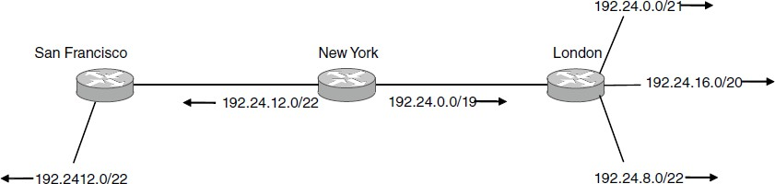
IP Addresses (4) – Longest Matching Prefix
How router decides which routing-table entry to use when more prefixes matches the D IP address.
Router selects longest matching prefix
Suppose router has two routes router A- 192.24.0.0/16 & router B – 192.24.32.0/24
A packet arrives for 192.24.32.50 both routes match the D, but /24 is more specific than 16 thus the router sends the packet to router B.
S
outh Africa → Limpopo → Polokwane → Mankweng
Except for this
Main prefix goes this way

Slide 68
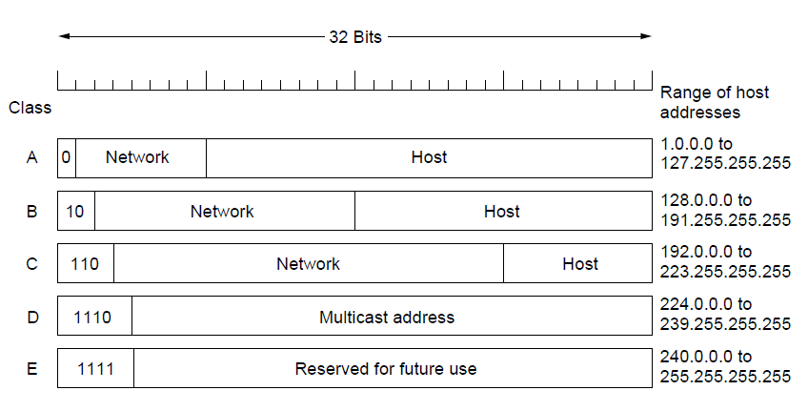
IP Addresses (5) – Classful Addresing
Old addresses came in blocks of fixed size (A, B, C)
Carries size as part of address, but lacks flexibility
Called classful (vs. classless) addressing
Issue is that these fixes are inflexible & could waste large number of IP addresses
Which is why classless addressing was preferred using /19, /22 etc.

Slide 69
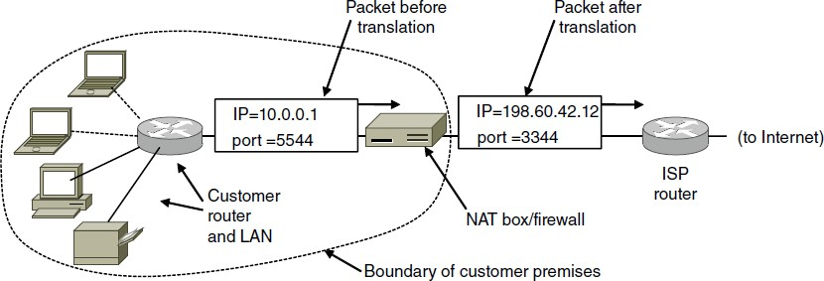
IP Addresses (6) – NAT
•
Allows devices on a private network to share one public IP address when comm. with the internet
NAT device (router) translates devices’ private addresses & and the public IP address.
Several nodes share same public address, NAT also uses TCP/UDP port numbers to vary their connections
•
•

Slide 70
Example
At home you may have a laptop with 192.168.1.10 and a phone with 192.168.1.20. Both access the Internet through a router with a single public IP address. The router might distinguish their connections using different port mappings, such as port 1111 for the laptop and port 2222 for the phone. When responses arrive, NAT checks its mapping table and sends each response to the correct internal device.
CN5E by Tanenbaum & Wetherall, © Pearson Education-Prentice Hall and D. Wetherall, 2011

Slide 71
IP Version 6 (1)
Major upgrade in the 1990s due to impending address exhaustion, with various other goals:
Support billions of hosts
Reduce routing table size
Simplify protocol
Better security
Attention to type of service
Aid multicasting
Roaming host without changing address
Allow future protocol evolution
Permit coexistence of old, new protocols, …
Deployment has been slow & painful, but may pick up pace now that addresses are all but exhausted

Slide 72
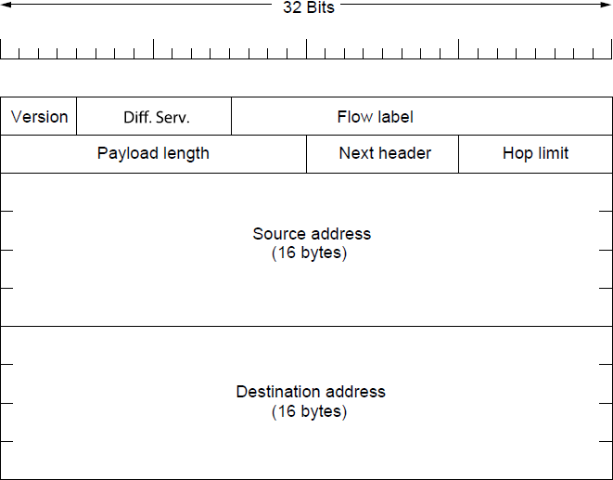
IP Version 6 (2 )
IPv6 protocol header has much longer addresses (128 vs.
32 bits) and is simpler (by using extension headers)

Slide 73
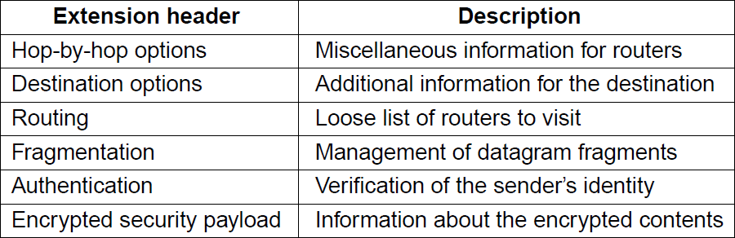
IP Version 6 (3)
IPv6 extension headers handles other functionality

Slide 74
╔══════════════════════════════╗
✨ SAVE THE DATE! ✨
║ ║
║ ☕ LET’S MEET ☕ ║
║ ║
║ T U E S D A Y ║
║ ║
║ Learn • Discuss • Grow ║
║ ║
║ SEE YOU THERE! ✨ ║
╚══════════════════════════════╝
74

Slide 75
Internet Control Protocols (1)
IP works with the help of several control protocols:
ICMP is a companion to IP that returns error info
  Required, and used in many ways, e.g., for traceroute
ARP finds Ethernet address of a local IP address
  Glue that is needed to send any IP packets
  Host queries an address and the owner replies
DHCP assigns a local IP address to a host
  Gets host started by automatically configuring it
  Host sends request to server, which grants a lease
CN5E by Tanenbaum & Wetherall, © Pearson Education-Prentice Hall
and D. Wetherall, 2011

Slide 76
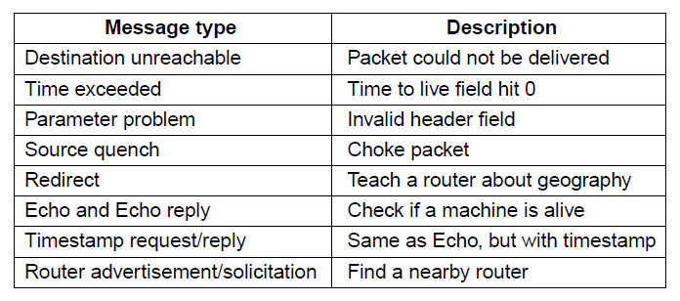
Internet Control Protocols (2)
Main ICMP (Internet Control Message Protocol) types:
CN5E by Tanenbaum & Wetherall, © Pearson Education-Prentice Hall
and D. Wetherall, 2011

Slide 77

Internet Control Protocols (3)
ARP (Address Resolution Protocol) lets nodes find target Ethernet addresses [pink] from their IP addresses
CN5E by Tanenbaum & Wetherall, © Pearson Education-Prentice Hall and D. Wetherall, 2011

Slide 78

Label Switching and MPLS (1)
MPLS (Multi-Protocol Label Switching) sends packets along established paths; ISPs can use for QoS
Path indicated with label below the IP layer
CN5E by Tanenbaum & Wetherall, © Pearson Education-Prentice Hall
and D. Wetherall, 2011

Slide 79

Label Switching and MPLS (2)
Label added based on IP address on entering an MPLS network (e.g., ISP) and removed when leaving it
Forwarding only uses label inside MPLS network
CN5E by Tanenbaum & Wetherall, © Pearson Education-Prentice Hall
and D. Wetherall, 2011

Slide 80
IP Addressing & Subnetting

Slide 81

The importance of IP
81

